Slide 1
SAP and FINANCIAL STATEMENTS 101
Tammie Holland, CBC MWR Business Manager
228-871-2296
TAMMIE.HOLLAND@NAVY.MIL

Slide 2
Basic Facts
NAVY’s Fiscal Year is from 1 October - 30 September
Financial transactions occur when there is $ exchanged
There are three sources of $ used to perform financial transactions – NAF, APF and UFM
NAF (Non Appropriated Funds - Monies received from sales of goods and services to DoD military, civilian personnel, and their family members by MWR, CYP, and NGIS operations and NOT subject to Congressional appropriation or authorization)
APF (Appropriated Funds - Governed by the Appropriations Bill, which authorizes governmental spending for mandatory programs)
UFM (Uniform Funding Management - practice designed to aid in the timely execution of Appropriated Funds (APF) in support of Department of the Navy (DON) MWR programs. The UFM practice does not change the level of authorized APF support; rather, it alters the billing process to allow for a more timely cash flow for MWR activities. )
SAP/AIMS is the accounting database used to record MWR/CYP Financial transactions. (SAP- SYSTEMS, APPLICATIONS, PRODUCTS & AIMS - ACCOUNTING INFORMATION MANAGEMENT SYSTEMS)

Slide 3
SAP/AIMS
When a FINANCIAL TRANSACTIONS occurs, it is recorded in SAP/AIMS VIA ACCOUNTS.
SAP/AIMS HAS MANY ACCOUNTs aka General Ledger Accounts WHICH ARE COLLECTIVELY CALLED “ THE CHART OF ACCOUNTS (COA)”. The AIMS Chart of Accounts is a standardized system used in Navy non-appropriated fund accounting to define and track both revenue and expenses. Because account numbers and descriptions may change from one budget year to another, be sure to obtain a current copy of the AIMS Chart of Accounts from the Business Office.
Each account within the COA has six digits (i.e. XXXXXX)). The first three digits are often termed the "core" or "primary number" and identify the account type (e.g., Asset, Liability, Expense, Income). The last three digits are used to further specify the meaning of the transaction.
For example, an account ending in ‘89’ is used for UFM purposes only.
Since there are many programs in CYP/MWR, we use a five digit cost center to identify which activity experienced the financial transaction.
Culmination of Financial Transactions result in a Financial Statement.

Slide 4
FINANCIAL PURPOSE?
To monitor monthly performance
Whenever Operating Targets, Financial Plan input, or additional reviews are required.
To brief program execution to the Commanding Officer on a monthly basis
To obtain the information needed to ensure Program funding
To obtain your Program’s UFM control figures
Before authorizing/requesting expenditures
To maintain a wish list of authorized expenses

Slide 5
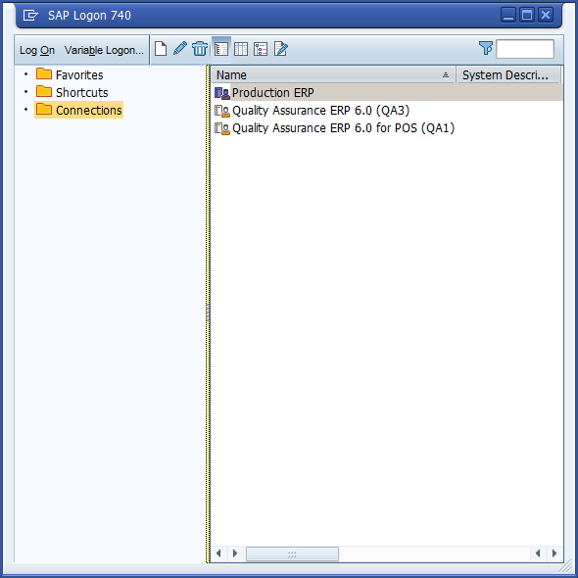
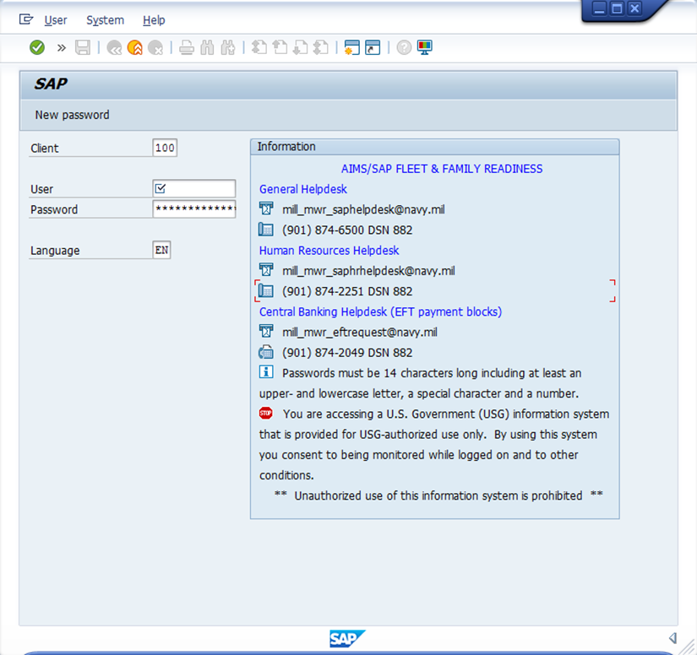
SAP/AIMS APPLICATION
Logging In – USE PRODUCTION ERP
Select LOG ON >Enter USERNAME AND PASSWORD
Case sensitive, so be careful
To obtain a user name and Password, see your local Business Manager
*CITRIX access is needed for SAP

Slide 6
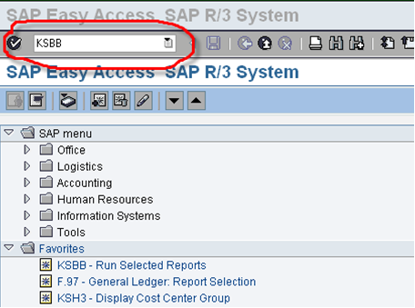
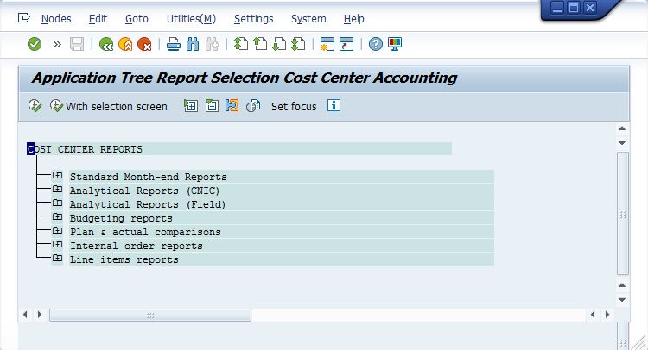
ACCESSING THE FINANCIAL STATEMENTS (cost center reports)
1. Enter the transaction code KSBB in the Command Field.
Then press enter or click on the “enter button” (green circle with a check mark). This will take you to the hierarchy of the Cost Center Reports.
2. Typically, you will use the reports in the Cost Center Reports hierarchy entitled,
“Standard Month-end Reports.”
Clicking the plus (+) symbol in any of the folder icons will expand the reports in that folder.
Clicking the minus (-) symbol in any of the folder icons will collapse the reports into that folder.

Slide 7
Standard Month End Reports
3. Selecting the plus (+) symbol on the folder titled “Standard Month-end Reports”, yields a list of the most commonly used reports to perform financial analysis.
4. The Budget Performance Activity – New
is a preferred tool.
The Budget Performance Activity (BPA) report shows planned (budgeted) data with a traditional profit and loss (P&L) statement. It is the only SAP/AIMS report that presents the performance of all accounts of a Cost Center in one report.
5. To select, double left click on desired report

Slide 8
Budget Performance Activity – New (BPA)
6. Enter Fiscal year
7. Enter Period (1-12)
Example: Sept = period 12 (fiscal yr – 10/01-09/30)
8. Enter Cost Center Group –
(Grouping of similar activities)
9. Select Execute (Green Check Mark) to run the report and see the results

Slide 9
Select a report under COST CENTER REPORTS
based on the type of financial information needed.
A new CYP, NGIS, or MWR Program Manager may wish to start reviewing and analyzing one or more of the reports for the previous closed-out month.

Slide 10
Questions?

